Slide 1
Emergent Properties, Models, and Laws of Behavioral Similarities within Groups of Twitter Users
Shaikh Sahil Ahmed (192474)
Sampat Kr Ghosh (192655)
Kushal Mondal (192596)

Slide 2
Paper chosen for implementation
Emergent properties, models, and laws of behavioral similarities within groups of twitter users by Stefano Cresci, Roberto Di Pietro, Marinella Petrocchi, Angelo Spognardi, Maurizio Tesconi. [Computer Communications Volume 150, 15 January 2020, Pages 47-61]

Slide 3
Agenda
Introduction
Literature Survey
Outcome of Literature Survey
Problem Statement
Objectives
Methodology
Proposed enhancements/novelty
Work done and Implementation
Experimental Results and analysis
Results of Innovative work done
Individual Contribution
Conclusion and Future Work

Slide 4
Introduction
In the field of social media, such as on Twitter, there are various accounts that are not genuine.
So, it is difficult for a normal user to know about a genuine person.
In this project, we are investigating the fundamental laws that drive the occurrence of behavioral similarities among Twitter users and also highlighting the significant differences between spambot and legitimate accounts.

Slide 5
Literature Review
Authors | Methodology | Advantages | Limitations
Longbing Cao | Used behavior informatics(BI) in order to support explicit and quantitative behavior involvement through a conversion from source data to behavioral data, and further conduct genuine analysis of behavior patterns and impacts. | Worldwide adoption OSNs, search engines, and e-commerce platforms | Users behaviors depend on content, intentions and contexts
Lei Tang | Study of collective behavior in a social networking environment | Highlighted that our online behaviors are very diverse and heterogeneous | Focused on individual users, rather than on communities or groups of users, despite their importance in OSNs
Stefano Cresci et. al | Demonstrate that the number and the extent of behavioral similarities within a group of Twitter users obey a log-normal distribution | The paper we selected is the continuation of this paper | They didn’t design a bot detection system using the characterization

Slide 6
Outcome of Literature Review
In the paper, the authors aimed at filling the gap in analysis mentioned above by giving a rigorous characterization of online behaviors and of the behavioral similarities among a group of OSN users.

Slide 7
Problem Statement
The extent of behavioral similarities within a group of Twitter users.
Difficult for recognizing the differences between bots and human.
So, highlighting significant differences between spambot and legitimate accounts, these results raised questions regarding the amount of behavioral similarities of the latter.

Slide 8
Research Objectives
Investigating the fundamental laws that drive the occurrence of behavioral similarities among the Twitter users, employing a DNA-inspired technique.
Characterizing the main properties of such models and identifying the models that better resemble human behaviors in Twitter.
Implementation of a bot detection system.

Slide 9
Methodology
The work used a collection of tweets made by groups of bots and genuine users to conduct experiments.
The twitter data was taken and processed to make it eligible for quantitative analysis.
The twitter data was categorized in several ways to support experiments of different types.
Categorically the twitter data was represented with sets of strings of chosen characters from a finite alphabet set.
String analysis processes were applied to the sets of strings to get an insight to the tweets made by users and bots.

Slide 10
Proposed enhancements/novelty
Bot detection in twitter using kaggle dataset as referenced :
https://www.kaggle.com/charvijain27/detecting-twitter-bot-data/data#

Slide 11
Work done and Implementation
The dataset contains tweets and users data for one group of genuine users and three groups of twitter bots. There are more than 8.5 millions tweet data from more than 3000 genuine users. Three groups of bot users have more than more than 5 million tweet data from more than 3000 bots.
Data Processing
First Category of Dataset
Three letters from English alphabet were chosen to indicate the type of tweets:
A = normal tweet.
C = reply to a tweet.
T = retweet.

Slide 12
Work done and Implementation
Second Category of Dataset
Here tweets were categorized by its content in two different levels. The first level had 3 types of contents and were indicated using three characters:
N = tweet contains no entities.
E = tweet contains one more entity, either hashtag, or mentions or urls.
X = tweet contains entities of mixed types.
The second category had an extended part where the tweets were further divided:
N = normal text tweet
U = tweet contains one or more urls
H = tweet contains one or more hashtags
M = tweet contains one or more mentions
X = tweet contains entities of mixed type.

Slide 13
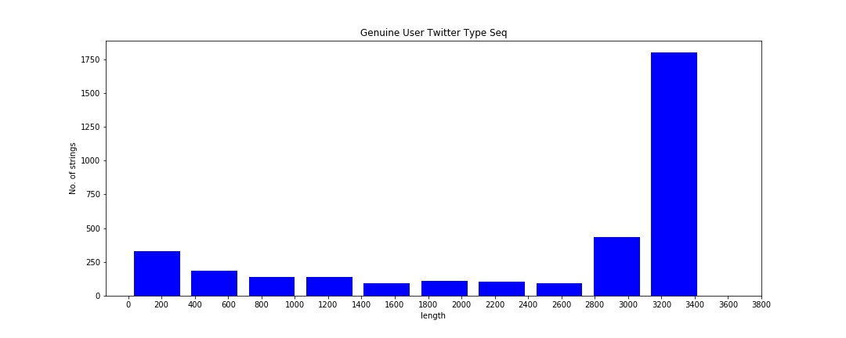
Work done and Implementation
Data Visualization
We plotted histograms of string length against the number of strings for each group of users
1st : group of genuine users.
2nd : groups of bot users.
Plot for group of genuine users:
The following plot for genuine users group shows that nearly half of genuine users have a very high number of tweets.

Slide 14
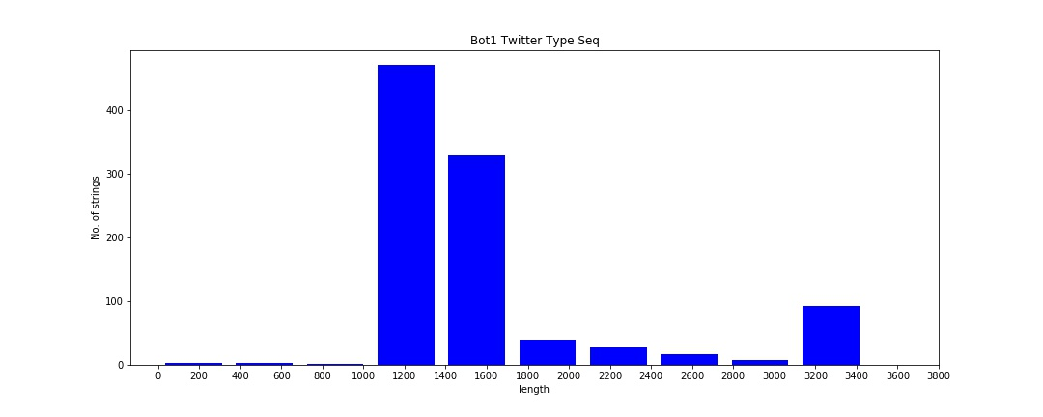
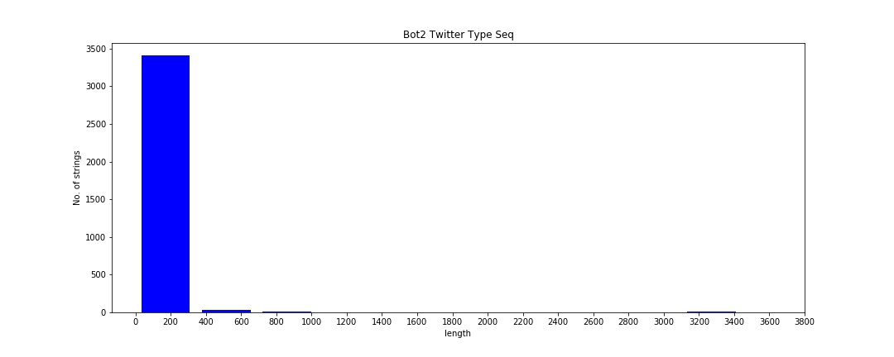
Work done and Implementation
Plot for bot group 1:
Plot for bot group 2:

Slide 15
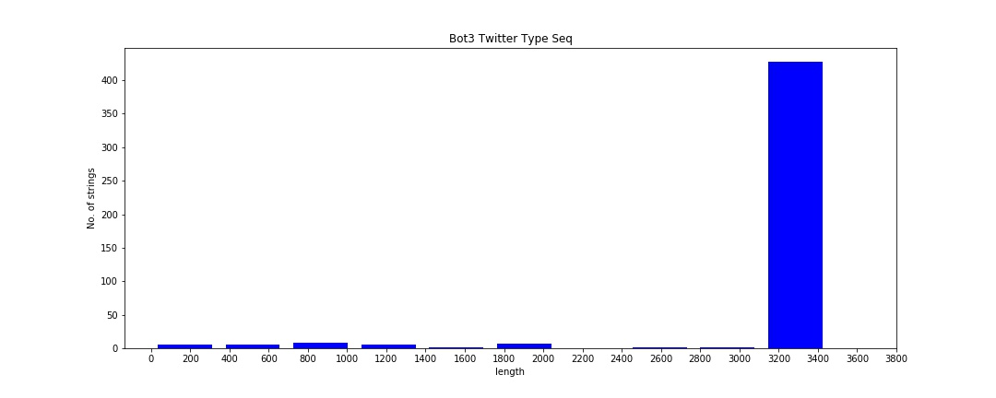
Work done and Implementation
Plot for bot group 3:
In case of bot users a very high number of bots are very active in twitter where other bots are not so active at all.
Among the three bot groups, group 3 is more similar to the genuine users.

Slide 16
Experimental Results and Analysis
We have tried to find the longest common substring length among these strings of each group.
The efficient approach to find the longest common substring has a time complexity of O(n+m), where n = length of one string and m = length of the string.
This approach uses dynamic programming paradigm. When this approach is extended to k number of strings then the time complexity becomes O((n+m)*k).
We have tried to find the length of longest of common substrings for k=2 to n number of strings.
The probability of finding the longest common substring(LCS) is very high in longer strings than the shorter ones since each string had very small number unique characters.
We also observed that if L is the LCS of k strings then L is a superstring of the LCS of k+1 strings.

Slide 17
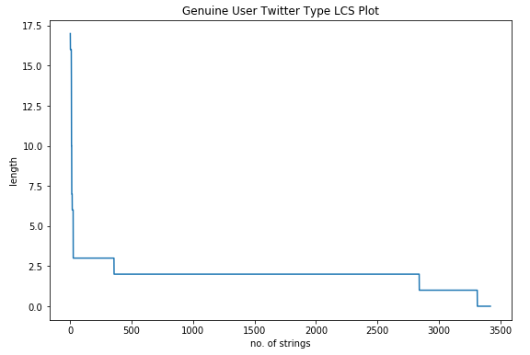
Results of Innovative Work
After analysing we got the plot for genuine user twitter type LCS plot and bot user twitter type LCS plot.
The plot is generated taking number of string on x-axis and length in y-axis.
Genuine user twitter type LCS plot:

Slide 18
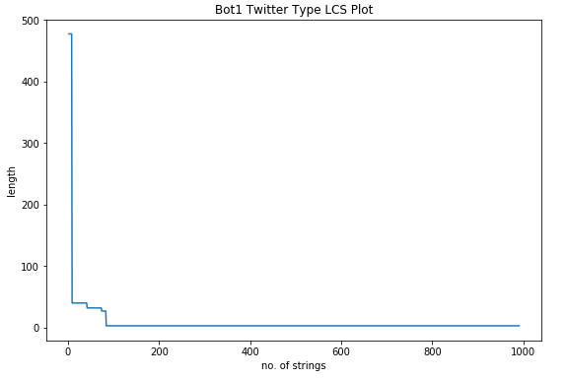
Results of Innovative Work
Bot user twitter type LCS plot:

Slide 19
Conclusion and Future Work
The paper does not provide any bot detection model as such.
It only suggests that a string comparison based analysis can be a way to detect if a group of twitter users is more dominated by bots or genuine users.
Therefore it is inefficient to create a dataset that will aid us to create a machine learning model which can detect a bot in twitter given some features.
Therefore we have been looking for other dataset for that purpose.
After that we will try to develop a classification model for bot detection as part of our enhancement to this work.

Slide 20
Individual Contribution
Data Visualization - Kushal Mondal
LCS designing - Sampat Kr Ghosh
Data Preprocessing & Graph plotting - Shaikh Sahil Ahmed

Slide 21
References
S. Cresci, R. Di Pietro, M. Petrocchi, A. Spognardi, M. Tesconi, The paradigm-shift of social spambots: Evidence, theories, and tools for the arms race, in: WWW’17 Companion, ACM, 2017
S. Cresci, R. Di Pietro, M. Petrocchi, A. Spognardi, M. Tesconi, DNA-inspired online behavioral modeling and its application to spambot detection, IEEE Intell. Syst. 31 (5) (2016)
L. Tang, X. Wang, H. Liu, Scalable learning of collective behavior, IEEE Trans. Knowl. Data Eng. 24 (6) (2012)
L. Cao, Y. Ou, S.Y. Philip, Coupled behavior analysis with applications, IEEE Trans. Knowl. Data Eng. 24 (8) (2012)

